Slide 1
Recommender System
Tan Willy (DSI 11)

Slide 2
Content
Business Objective
Data Objective
Exploratory Data Analysis
Approach Taken
Evaluation & Results
Possible Impact

Slide 3
Business Objective
To identify which video games are the most similar in order to recommend to end users who might consider purchasing the products and increase company sales.

Slide 4
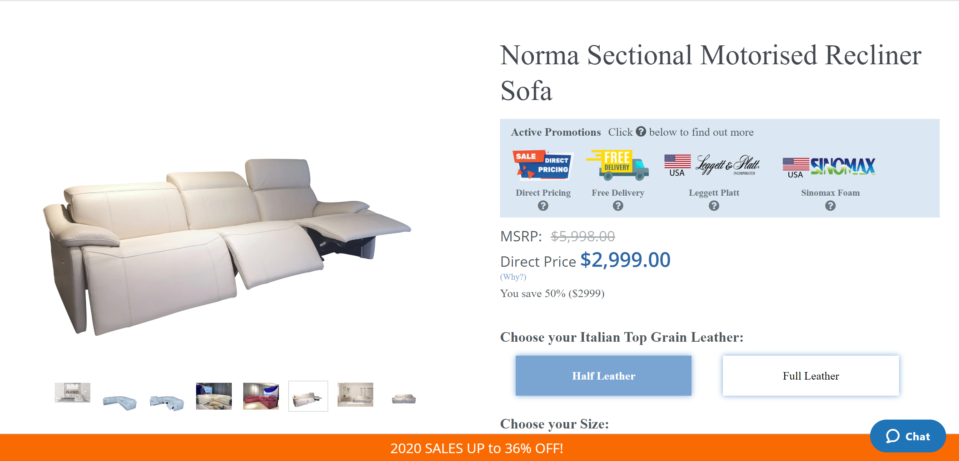

Slide 5


Slide 6
Data Objective
Amazon Dataset (2018)
Review Data
- Asin
- ReviewerID
- Ratings
Game Data
- Asin
- Title

Slide 7
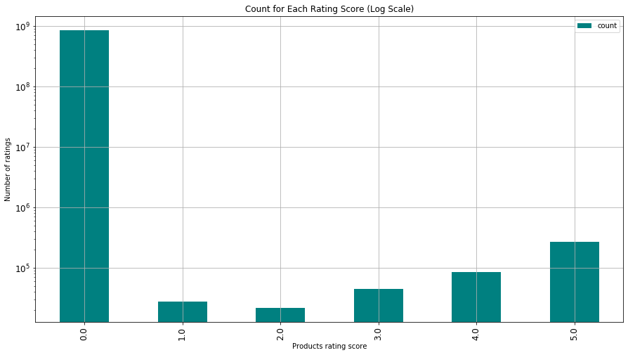
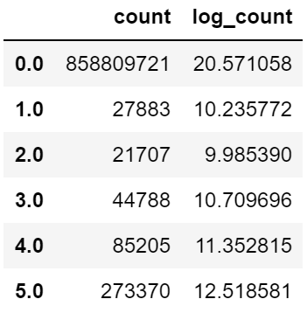
Exploratory Data Analysis

Slide 8
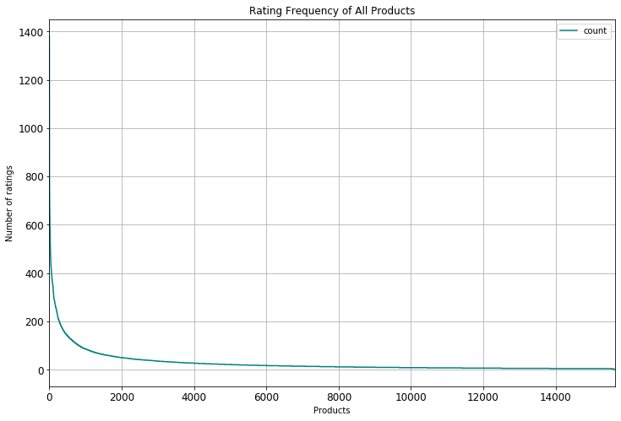
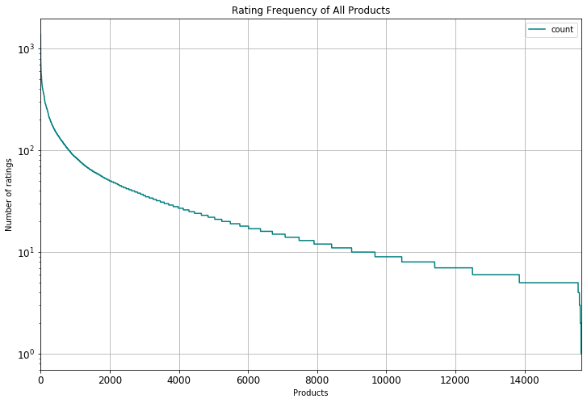
Exploratory Data Analysis

Slide 9
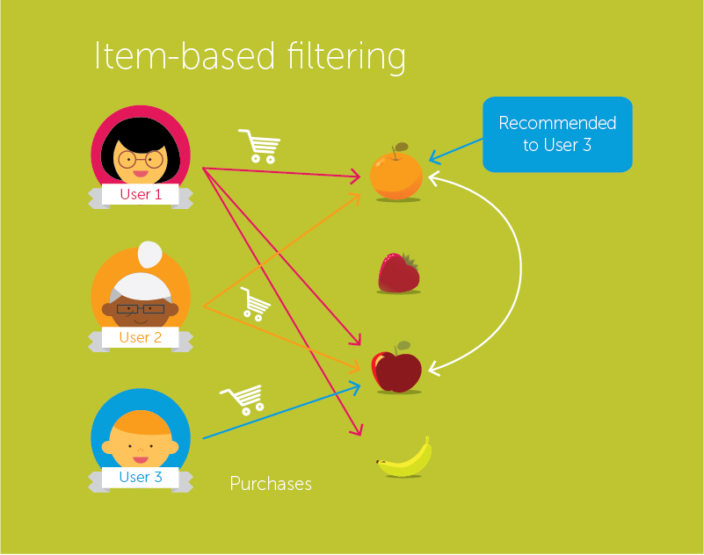
Approach Taken

Slide 10
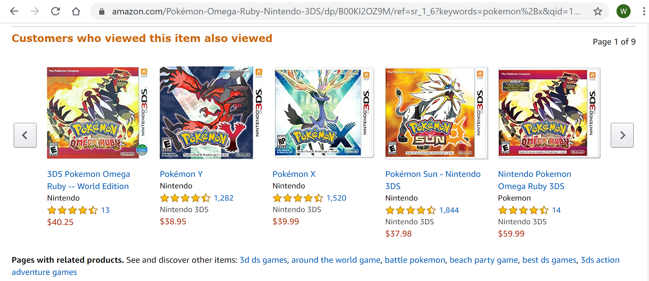
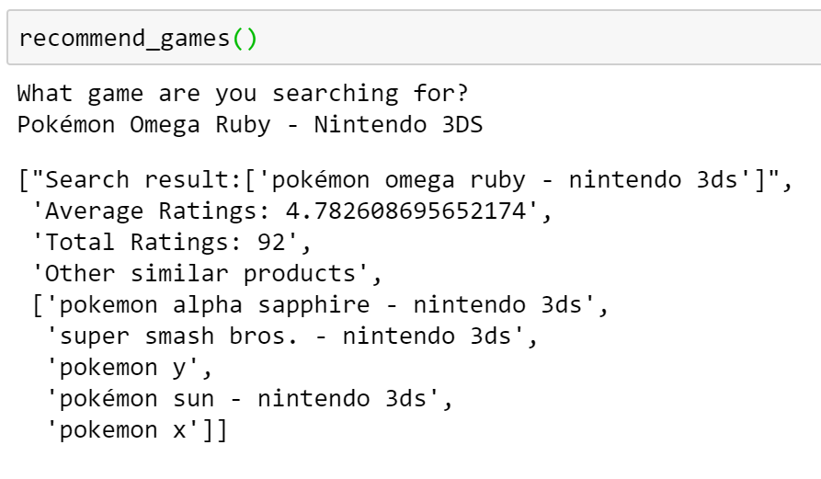
Evaluation & Results
Precision = 0.6

Slide 11
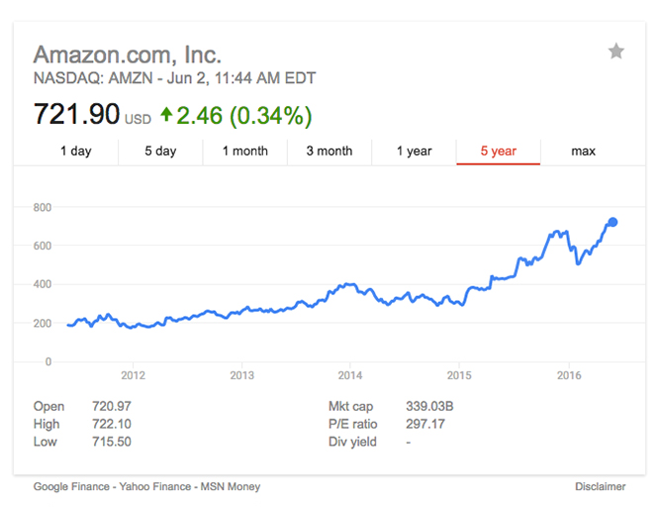
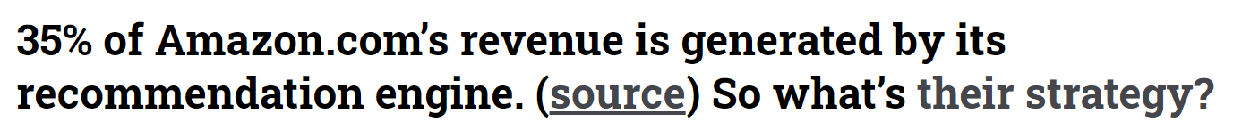
Possible Impact

Slide 12
What’s Next?
Deploy recommender system to a web page
Upload large dataset to AWS Relational Database Service
Run Flask to host web server
Improve user experience and aesthetics of web page

Slide 13
End of Presentation
https://github.com/Tan-Willy/game_recommender
https://www.linkedin.com/in/tanwilly26/

